Slide 1
Forces shaping genetic diversity
Mutation
Random Genetic Drift
Recombination
Migration
Natural Selection

Slide 2
Classes of mutation
Germline vs. somatic
Coding vs. Noncoding
Missense vs. Nonsense
Synonymous vs. Nonsynonymous
Neutral vs. Gain of function vs. Loss of function
Indels (including Transposable Elements)
Splicing (cryptic, frameshift, …)
Duplication
Unequal exchange (Philadelphia chromosome)

Slide 3
Estimation of mutation rate
Inter-species divergence
Pedigree data
Extremely rare variants in huge samples
Mutation spectrum
Mutation-accumulation lines

Slide 4
Mutations as seen through SUBSTITUTIONS and SNPs.
Human-mouse divergence Human polymorphism
0.108
0.111
A C
T G
A C
T G
0.308
0.278
0.071
0.089
0.090
0.143
0.354
0.274
0.068
0.103

Slide 5
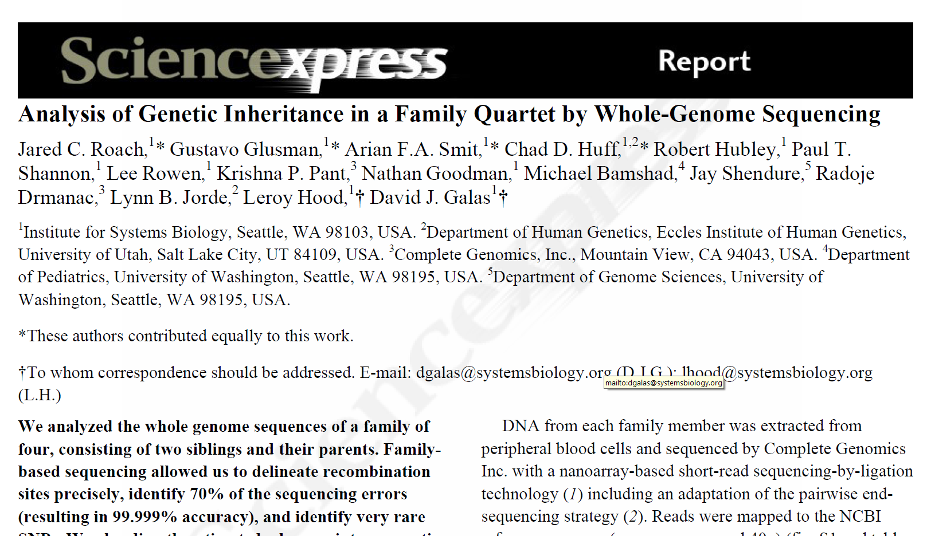
Full genome sequence of two parents and two offspring gave a mutation rate estimate of 1.1 x 10⁻⁸ per site per gen

Slide 6
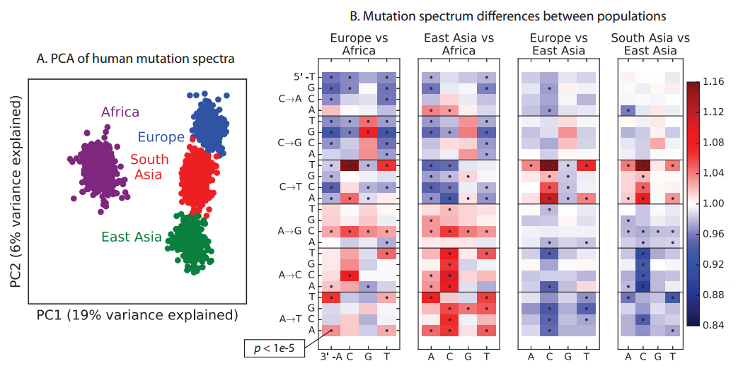
Mutation spectrum and context dependence of mutation rates
Harris and Pritchard 2017 eLife

Slide 7
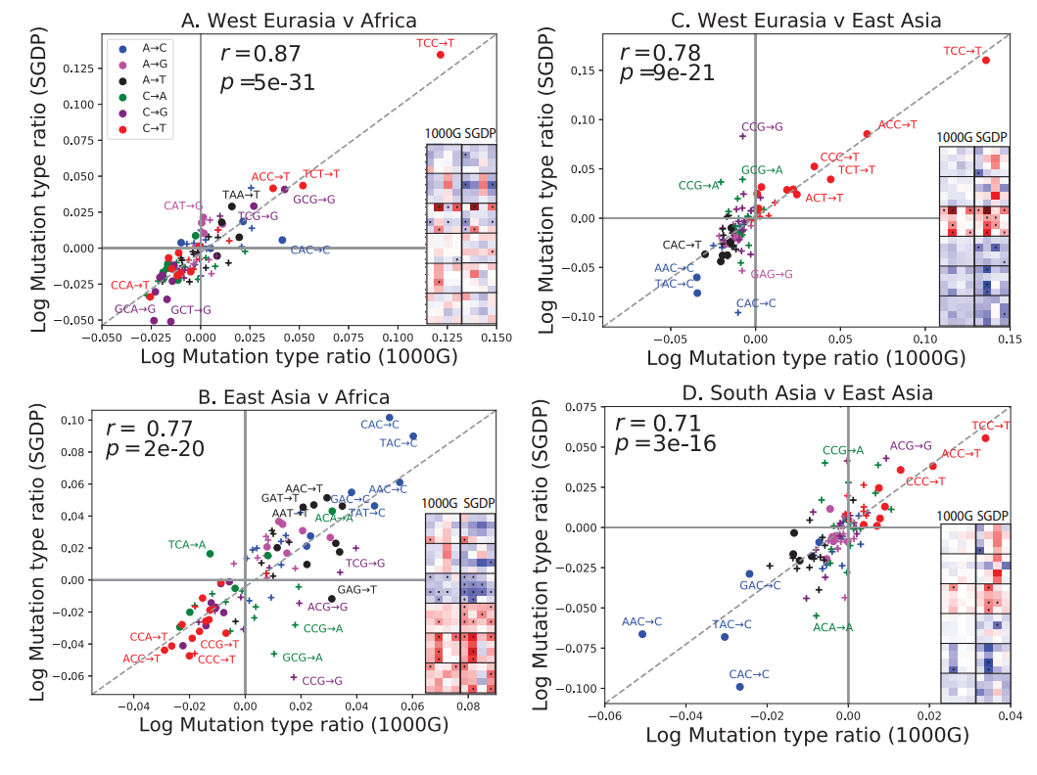

Slide 8
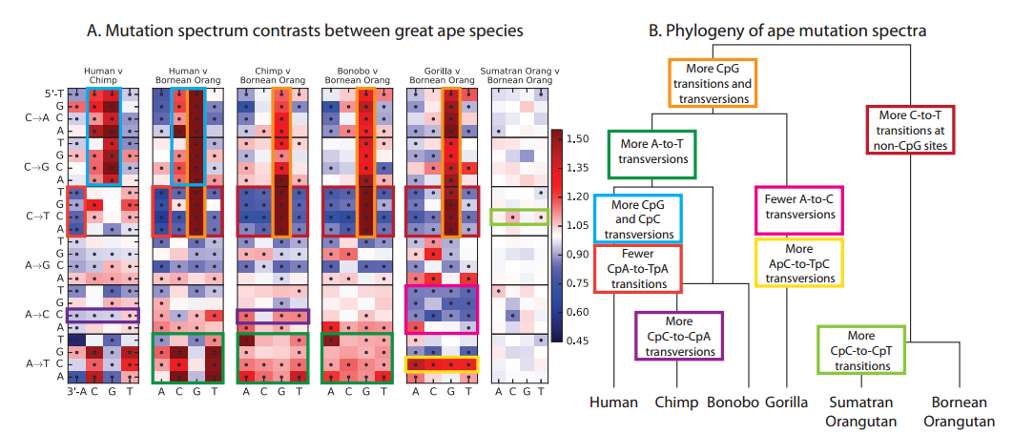

Slide 9
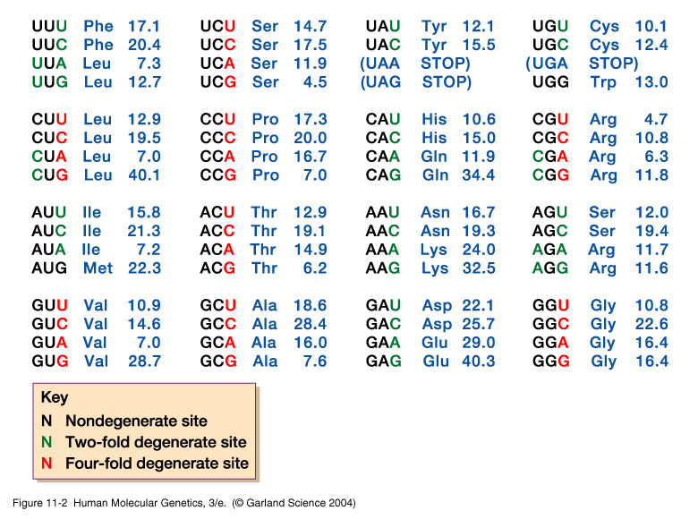
11_02.jpg

Slide 10
Random genetic drift
Pure drift models are rarely used for inference of natural populations, but model (lab) populations under short time scales can be modeled this way.
In this circumstance, drift is modeled as a Wright-Fisher process, with recurrent binomial sampling.

Slide 11
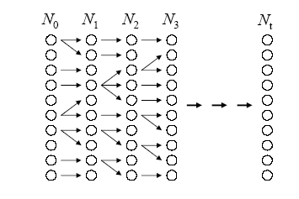
The Wright-Fisher drift model
Selfing allowed
Random mating
Non-overlapping generations
Constant population size
No migration
No selection
Notes:
Go to board

Slide 12
Pure Drift – Binomial sampling
Consider a population with N diploid individuals. The total number of gene copies is then 2N.
Initial allele frequencies for A and a are p and q, and we randomly draw WITH REPLACEMENT enough gene copies to make the next generation.
The probability of drawing i copies of allele A is:

Slide 13
Binomial sampling
If p = q = ½, then, for 2N = 4 we get:
i = 0 1 2 3 4
Pr(i)= 1/16 4/16 6/16 4/16 1/16
Note that the probability of jumping to p=0 is (1/2)^{2N}, so that a small population loses variation faster than a large population.

Slide 14
Binomial sampling
Pr(0 copies in next generation)= (1-p)^{2N}

Slide 15
Pure Drift: Wright-Fisher model
The Wright-Fisher model is a pure drift model, and assumes only recurrent binomial sampling.
If at present there are i copies of an allele, then the probability that the population will have j copies next generation is:
This specifies a Transition Probability Matrix for a Markov chain.

Slide 16
Wright-Fisher model
For 2N = 2, the transition probability matrix is:
j
0 1 2
0
i 1
2
Notes:
Draw transition diagram on the board

Slide 17
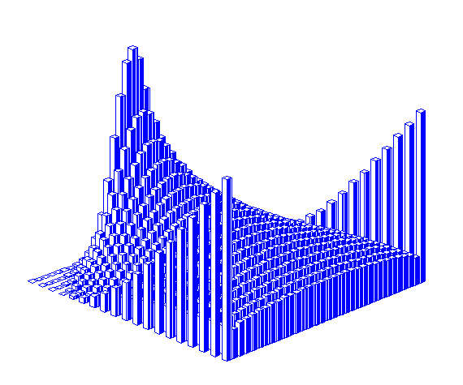
Wright-Fisher model
Probability of allele frequency at generation
Time
(generations)
Allele frequency
2N = 32

Slide 18
Wright-Fisher practical
Follow the instructions in “WrightFisherSim.txt” to learn some properties of this classic model.

Slide 19
Drift plus mutation
Mutation always happens, so the simplest model of drift usually also must incorporate mutation.
Mutation introduces all variation into the population, and drift always removes it. These two forces come to a balance – the mutation-drift balance.
Two primary models of this are the infinitely many alleles model (infinite alleles model) and the infinite sites model.

Slide 20
Infinite alleles model
Suppose each mutation gives rise to a novel allele.
Then no new mutant allele is IBD with any previous allele.
So what is the probability of IBD now?
And what happens to the probability of IBD over time?

Slide 21
Equilibrium F under infinite alleles
Solve for equilibrium by letting F_{t} = F_{t-1} = F*. After some algebra (and some simplifying assumptions), we get:
Notes:
Simplifying assumptions include assuming that mu is so small that the terms containing mu^2 are 0
And also that denominator and numerator 2mu terms more or less cancel each other out
So what happens when we change this 4nmu or theta term/

Slide 22
Steady state heterozygosity (H = 1 - F) under the infinite alleles model
H = θ/(1+θ), where θ = 4N_{e}μ

Slide 23
Infinite alleles model: Expected number of alleles (k) given sample size n and θ
Ewens 1972
θ = 4N_{e}μ
Note: assumes no recombination

Slide 24
Infinite alleles model:
Expected number of alleles
E(k)
(n)
θ =10 and θ=5

Slide 25
Infinite alleles model: Expected number of alleles (k) given sample size n and θ
Ewens 1972
θ = 4N_{e}μ
Note: assumes no recombination

Slide 26
Infinite alleles model:
Expected number of alleles
E(k)
(n)
Notes:
So now we have an equation that relates the sample size and theta to the expected number of alleles.
Can we come up with a test that can determine whether a given dataset fits well with the infinite alleles model under an assumption of neutrality

Slide 27
Infinite alleles model:
Expected number of alleles
E(k)
(n)
Notes:
So remember that F is a function of theta and that E(k) is a function of theta (given a particular sample size)
Then we can construct a relation between F and E(k) which we will use to determine if the sample follows the infinite alleles model.

Slide 28
The Ewens-Watterson test: a goodness of fit test to the infinite alleles model
Calculate observed F (homozygosity) from the data.
Sample size (n) and number of alleles (k) are sufficient statistics, under the Ewens’ sampling formula, to determine the expected distribution of F.
F will differ based on allelic configuration
Simulations are run to generate the null distribution of F given n and k.
Notes:
Now we have steady state prediction of F=1/(1+theta) and we have E[k]=f(theta)
These equations assume neutrality.
So now we can test a locus of interest to see if the observed f and the observed number of alleles match what we should observe under the infinite alleles model under neutrality
If the values differ from what we should expect, then perhaps another force is at play…perhaps natural selection
Need to do simulations because although F is a function of the number of unique alleles, the configuration of the those alleles (the number of individuals in the sample having each allele) will differ which will affect the homozygosity of the sample.
Ok, so in addition to comparing real data to a neutral model, what can we say about the average lifetime of a specific allele?

Slide 29
Mutation-drift and the neutral theory of molecular evolution (Kimura and Ohta 1969)
4N
1/μ
1
Allele
Freq.
0
Time
Assuming that an allele is eventually fixed…
mean time between origination and fixation = 4N generations
Mean interval between fixations = 1/μ generations.

Slide 30
Infinite sites model: each mutation generates a change at a previously invariant nucleotide site
Drift occurs as under the Wright-Fisher model.
Mutations arise at rate μ at new sites each time.
Does this model give rise to a steady state?
How many sites do we expect to be segregating?
What should be the steady state frequency spectrum of polymorphic sites?

Slide 31
Infinite sites model
Define S₂ as the number of segregating sites in a sample of 2 gene copies.
(Watterson 1975)
(infinite-sites model)
So, the probability that a sample of 2 genes has zero segregating sites is:
Note that Pr(S₂=0) is the same as the probability of identity, or F.

Slide 32
Infinite sites model: The expected number of segregating sites (S) depends on θ and sample size (n)
(infinite-sites model)
Notes:
So as long as you have an estimate of theta for your sample, you can calculate the expected number of segregating sites over your sample.
Another important approximation, is the E[pi]. Pi represents the number of pairwise differences within your sample. E[pi]=theta. Comparing these two estimates of theta are an integral part of the Tajima’s D statistic. (kimura 1968)
You can then compare the expected number of segregating sites for a particular sample size to the one that you observe in your data.
For example, in the next slide.

Slide 33
Observed and expected numbers of segregating sites (Lipoprotein lipase, LPL)
observed
expected

Slide 34
How the site frequency spectrum is generated
The frequency spectrum
Site
163
975
1972
2188
3529
4424
4961
5286
7019
Sequence
1
A
G
G
C
T
T
A
A
A
2
A
T
G
C
T
C
G
A
A
G
T
G
T
T
C
A
C
G
Count
3
4
A
G
G
C
T
C
A
A
G
5
A
G
A
C
C
C
G
A
A
Frequency class:
1
2
1
1
1
4
2
1
3
Frequency class
Ancestral
Derived

Slide 35
Theoretical expectation for the site frequency spectrum
Under the infinite sites model, the expected number of (Tajima 1989; Fu and Li 1993)
singletons is θ doubletons is θ/2 tripletons is θ/3 … n-pletons is θ/n
Note that the expected number of singletons is invariant across sample sizes!

Slide 36
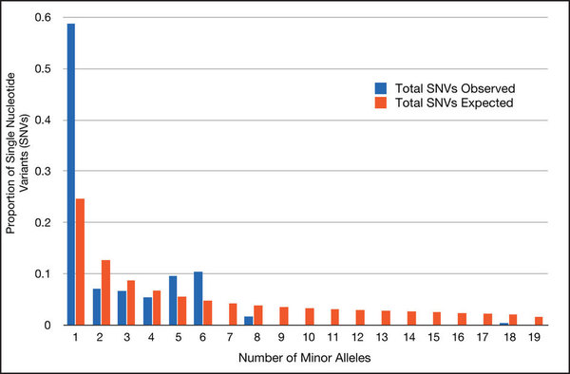
Nucleotide site frequency spectrum

Slide 37
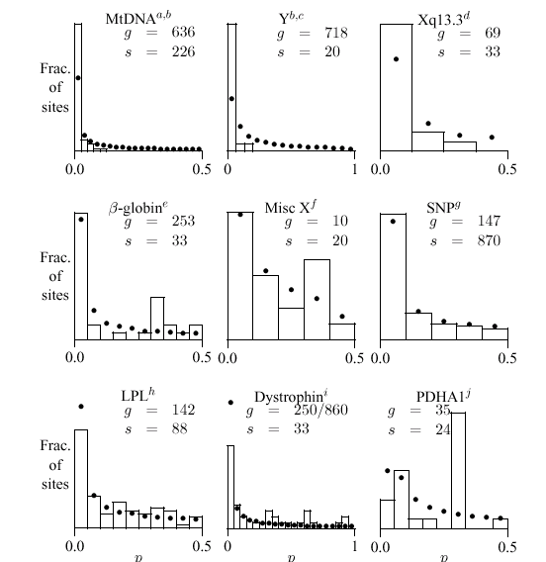
Some observed human site frequency spectra

Slide 38
Infinite-sites practical
Follow the instructions in “InfiniteSites.txt” and do exercises to test your understanding of the infinite sites model.

Slide 39
Estimation of recombination (rho = ρ = 4Nc)
Direct estimation of recombination requires counts of meiotic exchanges.
Even rather huge pedigrees have relatively few meiotic exchanges.
This means that pedigree-based linkage maps are of limited resolution (10 cM or so).
Fine-scale recombination is better inferred INDIRECTLY from LINKAGE DISEQUILIBRIUM.

Slide 40
Linkage disequilibrium measures
From the preceding equations for D, note that we can also write:
D = p_{AB}p_{ab} – p_{Ab}p_{aB}
The maximum value D could ever have is if p_{AB} = p_{ab} = ½. When
this is so, D = ¼. Likewise the minimum is D = - ¼ .
D’ is a scaled LD measure, obtained by dividing D by the maximum
value it could have for the given allele frequencies. This means
that D’ is bounded by –1 and 1.
A third measure is the squared correlation coefficient:

Slide 41
Equilibrium relation between LD and recombination rate
E(r²)
Ohta and Kimura 1971

Slide 42
Linkage disequilibrium decays across a gene

Slide 43
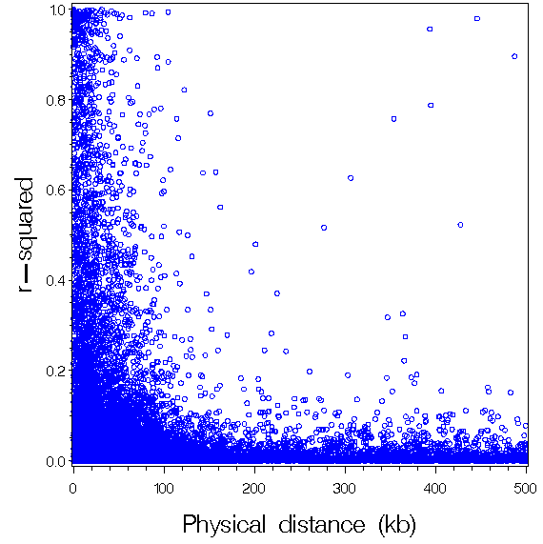
Linkage disequilibrium is rare beyond 100 kb or so

Slide 44
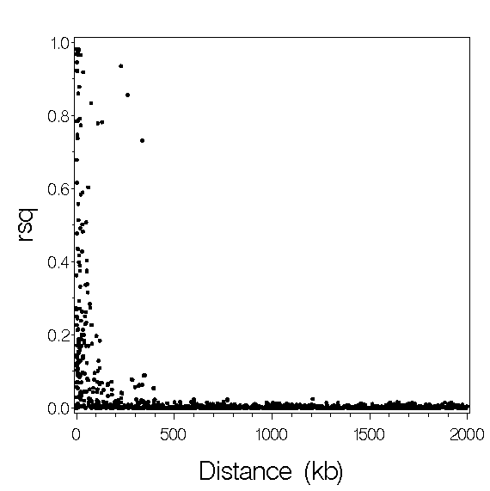
Beyond 500 kb, there is almost zero Linkage disequilibrium

Slide 45
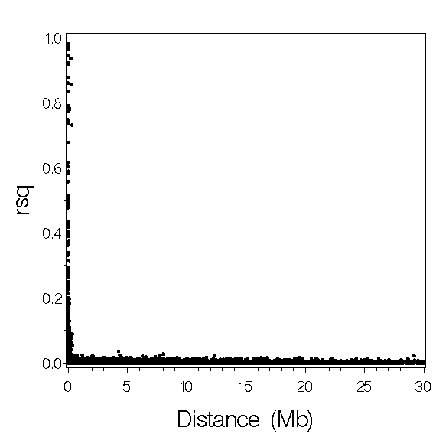
…so observing LD means the sites are likely to be close together

Slide 46
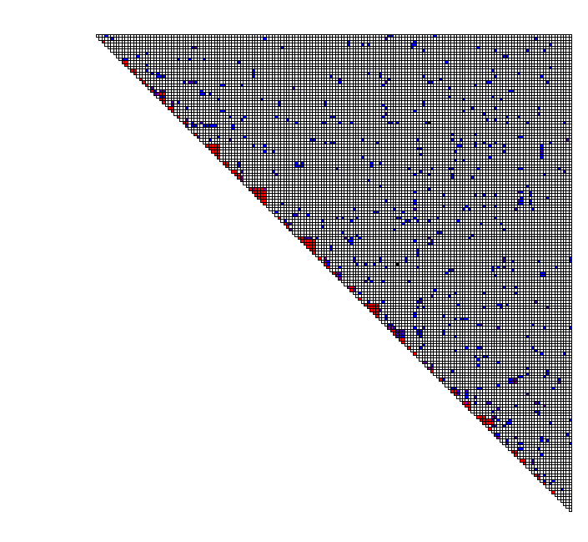
Patterns of LD can be examined by testing all pairs of sites
Each square shows the
Test of LD for a pair of sites.
Red indicates P < 0.001 by a
Fisher exact test.
Blue indicates P < 0.05

Slide 47
Rho can be estimated from the rate of decay of LD
|D’|
kb
Reich et al. (2001 Nature 411:199-204)

Slide 48
Terminology
Recombination Rate refers to the proportion of recombinants between a pair of sites in a collection of gametes.
Recombination Intensity refers to the recombination rate per unit of physical distance along the chromosome. It is expressed in cM/Mbp.
Population Recombination Rate (rho) is to recombination rate as θ is to mutation rate.

Slide 49
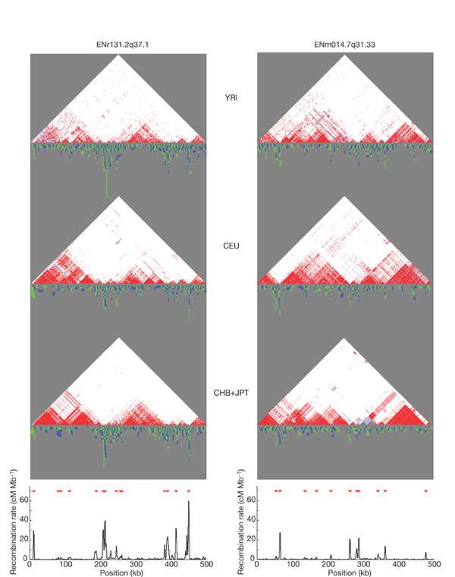
Average recombination intensity in humans is 1 cM/Mbp. Hotspots are up to 100 cM/Mbp.

Slide 50
Estimation of selection
Polymorphism vs. Divergence (Aida: HKA, MK)
Departure from expectation under a pure drift model
Departure of SFS from neutral (Pascale: Tajima D)
Excess IBD block size (Pascale: EHH)
With allele frequency dynamics – departure from expected dynamics
With detailed sampling: Selection Components Analysis

Slide 51
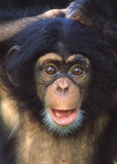
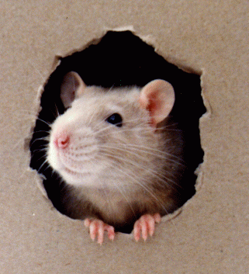

First genome-wide selection test:
d_{N}/d_{S} test with PAML
chimp
d_{N1}
mouse
d_{N2}
human
Mouse-human split: 80-110 MYA
Human-chimp split: 4.6 – 6 MYA
Clark et al. 2005 xxx)

Slide 52
Estimation of selection from allele frequency dynamics
For each generation transition, record the allele frequency and the change.
Wright-Fisher model implies binomial variance of allele frequency.
Can formulate a likelihood ratio test (LRT) for goodness-of-fit of Wright-Fisher.
The only parameter is N_{e}, which should be jointly estimated across all SNPs.

Slide 53
Allele frequency dynamics practical
Follow the instructions in “AlleleFreqDyn.txt” to assess whether allele frequency changes over time fit the neutral expectation.

Slide 54
Selection Components Analysis SCA: Gametic selection
H₀: Heterozygotes produce equal proportions of the two gametes (typically scored in offspring).
Test: Chi-square, or likelihood models.
Parameter: explicit ML estimates of segregation probabilities.

Slide 55
Gametic selection: do heterozygotes transmit both alleles equally frequently?
Aa
AA
Aa
Aa
AA
AA
H0: equal frequency of Aa & AA offspring

Slide 56
A full likelihood approach for testing for gametic selection
Male Female # kids w/genotype

Slide 57
A full likelihood approach for testing for gametic selection
Male Female # kids w/genotype

Slide 58
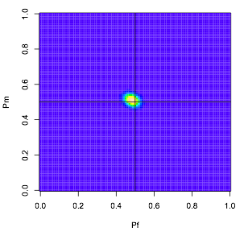
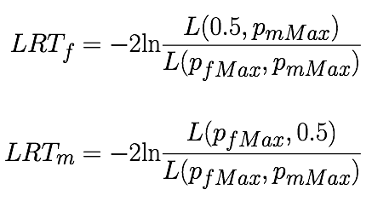
A full likelihood approach for testing for gametic selection

Slide 59
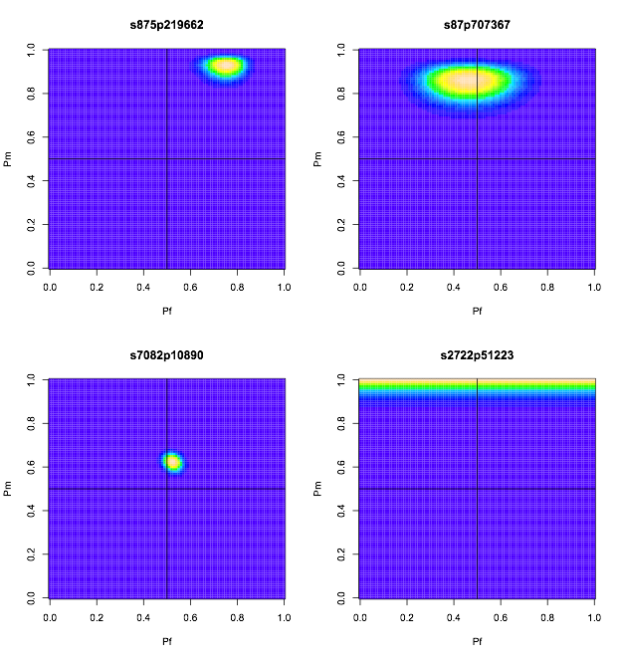
A full likelihood approach for testing for gametic selection

Slide 60
A full likelihood approach for testing for gametic selection

Slide 61
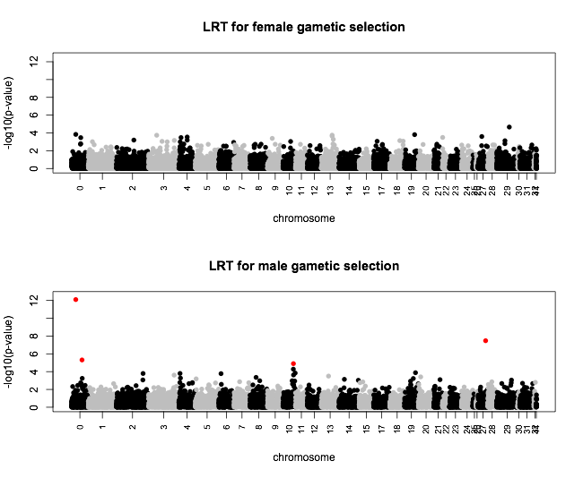
Four male gametic selection hits

Slide 62
SCA: Viability
H₀: All genotypes have the same probability of surviving from zygote to reproductive adult.
(A bit more subtle – all genotypes have the same survivorship curve)
Test: General linear models, accounting for other factors.
Parameters for predictive models are standard fitnesses inferred from the linear models.

Slide 63

General linear model for viability and fecundity
survival
breeding status
clutch size
y = Xβ + Zu + e

Slide 64

General linear model for viability and fecundity
individual ID
year
natal nest
parent ID
survival
breeding status
clutch size
y = Xβ + Zu + e

Slide 65

General linear model for viability and fecundity
individual ID
year
natal nest
parent ID
survival
breeding status
clutch size
y = Xβ + Zu + e
age
inbreeding coefficient
hatch date
nestling morphometrics
juvenile morphometrics
new breeder?
immigrant status
territory acquisition
# helpers
territory size
time since fire
habitat composition
pair experience
female breeder age
male breeder age
incubation date
density
breeding vacancies
rainfall
drought index
temperature
acorn abundance
etc.

Slide 66
General linear model for viability and fecundity
individual ID
year
natal nest
parent ID
survival
breeding status
clutch size
y = Xβ + Zu + e
age
inbreeding coefficient
hatch date
nestling morphometrics
juvenile morphometrics
new breeder?
immigrant status
territory acquisition
# helpers
territory size
time since fire
habitat composition
pair experience
female breeder age
male breeder age
incubation date
density
breeding vacancies
rainfall
drought index
temperature
acorn abundance
etc.
SNP genotype

Slide 67
SCA: Fecundity
H₀: All genotypes produce the same number of offspring
Test: General linear models, accounting for non-genetic influences, such as food availability, pathogen load, etc.
Parameters for predictive models are typically inferred from linear models (assuming no G x E)

Slide 68
SCA: Sexual selection
H₀: All genotypes that survive to adulthood have equal chance of becoming a reproductive adult.
Requires records of lifetime survival and reproduction.
Test: General linear models, accounting for non-genetic influences, such as local density, food availability, etc.
Parameters for predictive models are typically inferred from linear models (assuming no G x E)

Slide 69
Forces shaping genetic diversity
Mutation
Random Genetic Drift
Recombination
Migration
Natural Selection

